Slide 1

Course Introduction
Winter 17 - GEOG 371
GeoVisualization: Web Mapping
Bo Zhao Ph.D.
College of Earth, Ocean and Atmospheric Sciences
zhao2@oregonstate.edu

Slide 2
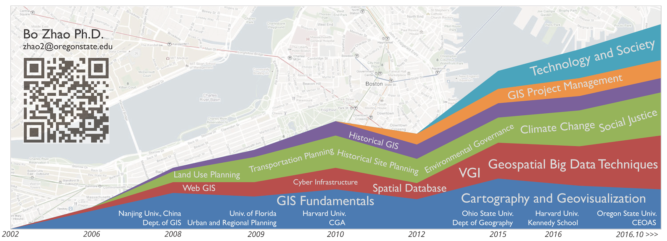
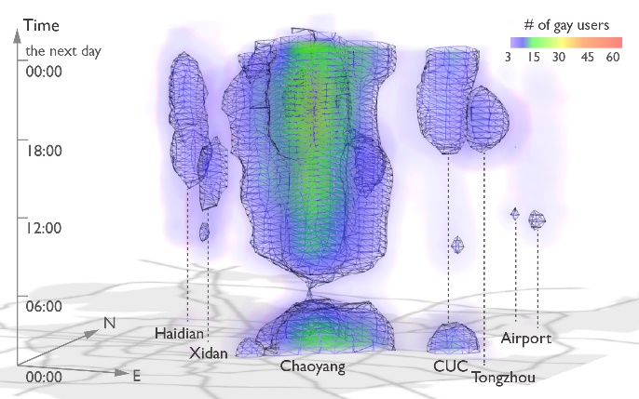
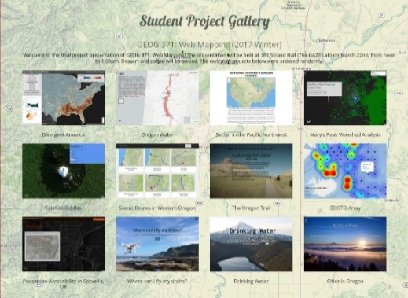
Teaching:
My goal is to help students efficiently and friendly communicate with the targeting audience using geovisualization.
Geog 370: Web Mapping
Geog 3/571: Web Mapping
Geog 4/572: Geovisual Analytics
Current Research:
Location-based Social Media; Location Spoofing
Storymap.js – a open source map storytelling library
Former Student Project Gallery
Visualization LGBT community in Beijing

Slide 3
Now, why are you here …?
So, why study Web Mapping?
Notes:
Now is your turn.

Slide 4
This course introduces current developments in web mapping and advanced cartographic skills applied to interactive map design.
By using open sourced libraries (Leaflet, Cesium, storymap.js, Bootstrap, jQuery), free or open source software (QGIS, Webstorm), project management services (GitHub), and web mapping services (GeoServer, MapBox), students can learn both the principles of web-based cartography and the practical skills for web mapping, and develop the capabilities of map aesthetics and critique.
The lectures focus on the theories and principles behind web mapping, including system architecture, responsive design, user graphic design, map design and geo-narrative.
The lab exercises focus on practical skills for web programming, 2d and 3d web mapping, web mapping services, and digital storytelling. The mid-term focuses on basic concepts and web programming techniques.
There is no final exam, but each student is expected to design a web maps and deploy it to an openly accessible server.
Programming Languages: Html, CSS, Javascript, Markdown and GeoJson
Desktop Software: Chrome, Webstorm, Typora, QGIS, and GeoServer
Web Services: GitHub, jsfiddle, Mapbox, W3Schools, and geojson.io
Libraries for Web Mapping: Jquery, Bootstrap, Leaflet, Storymap.js, and Cesium

Slide 5
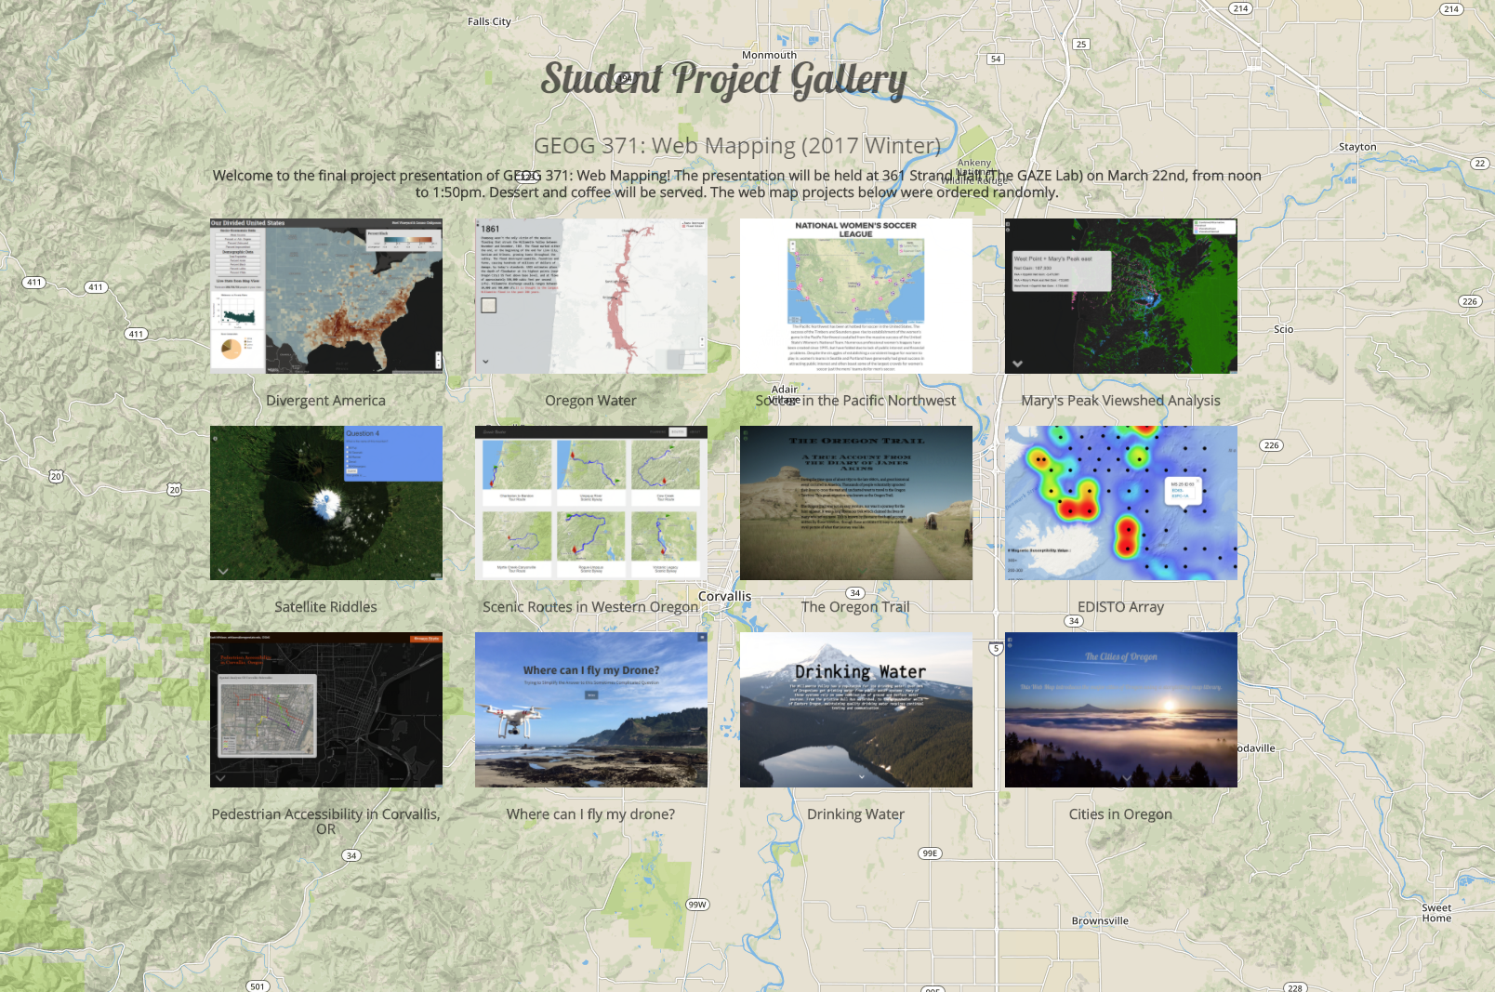
Student Project Gallery (2017 Winter)
http://geoviz.ceoas.oregonstate.edu/project_gallery/

Slide 6
Instructor: | Bo Zhao, zhao2@oregonstate.edu
 | Office: Strand Ag Hall 347
 | Office Hours: 1400-1500 W or by appointment
Credits: | 4
Meetings: | Lecture: MWF 1200-1250 @Wilkinson 235; Lab: Th 1000-1150 @Wilkinson 210
Prerequisites: | GEOG 201 or GEO 301
Grades: | Letter grading (A to F)
Notes:
To be short,

Slide 7
Texts
No required textbook.
Required papers and online materials will be available on the course GitHub.

Slide 8
Syllabus
Week | Lecture (M) | Lecture (W) | Lab (Th) | Lecture (F) | Reading
Wk * | N/A | Intro to the course | Lab 1: Project Management | Intro to Web Mapping | Markdown, GitHub, Typora, and Webstorm.
Wk 01 | Web Programming Basics I: HTML 5 and CSS | Web Mapping Architecture | Lab 2: Web Programming Basics | Lab 2: Web Programming Basics II: Javascript | HTML, CSS and Javascript
Wk 02 | Spatial Data for Web Mapping | Map Client I: Basics and Geographic Features | Lab 3: Web Map Design | Map Client II: Map Events and Mashup | Leaflet and JQuery
Wk 03 | Map Client III: Web Map Interaction | Map Server I: Intro to GeoServer | Lab 3: Cont'd | Map Server II: Styling | GeoServer docs
Wk 04 | Map Server III: Web Map Services | Base Map and Mapbox | Lab 4: Web Map Service | Map Server IV: Map Tiles | Bing Map Tile, and GeoWebCache
Wk 05 | Midterm Exam | Map Design I: Web Template and Framework | Lab 4: Cont'd | Map Design II: Bootstrap | Bootstrap docs, Kosara and Mackinlay (2013)
Wk 06 | Storytelling with Web Map I | Storytelling with Web Map II | Lab 5: Story Map | Map Design III: User Friendly Design Principles | storymap.js
Wk 07 | Time Series | Heat Map | Lab 5: Cont'd | Veterans Day
Wk 08 | Map Design IV: Map Critiques | 3D Web Mapping I: Basics | Lab 6: Thematic Map on the Virtual Globe | 3D Web Mapping II: Build a Virtual Environment
Wk 09 | 3D Web Mapping III: Thematic Map on a Virtual Globe | Final Project Discussion and Preparation | Lab 6: Cont'd | Thanksgiving Break
Wk 10 | Emerging Topics on Web Mapping | Final Project Discussion and Preparation | Final Project Discussion and Preparation | Final Project Presentation | Elwood et al. (2012), Sui and Zhao (2015)

Slide 9
Grading

Slide 10
Any questions?

